Slide 1
Machine Learning on Microcontrollers
Arduino Days 2024 @ Bitraf, Oslo Jon Nordby

Slide 2
Motivation
Extracting useful information from sensor data
Why ML on microcontrollers?
Notes:
Sensor data processing Extracting information from sensor data Especially rich/flexible sensors that contains many kinds of of information. Camera / Image. Microphone / sound / audio. Accelerometer / IMU.
Especially when it is not feasible / desirable to transmit the data to a bigger system for analysis Bandwidth. Range Power consumption Reliability

Slide 3
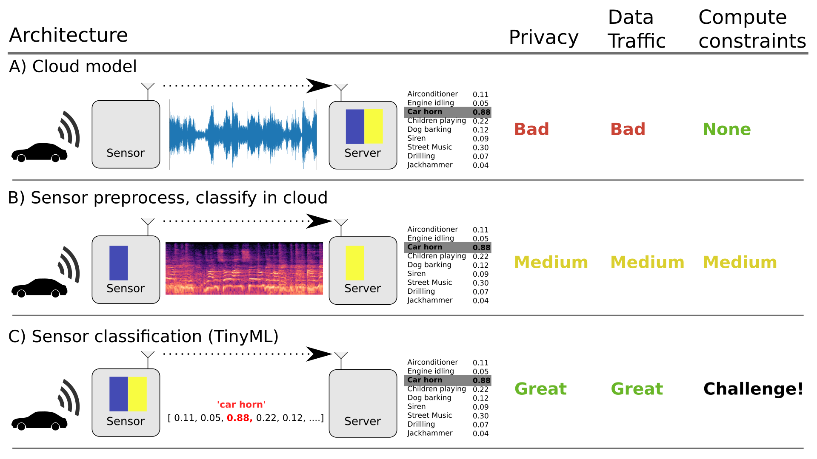
Notes:
Sensor data processing Extracting information from sensor data Especially rich/flexible sensors that contains many kinds of of information. Camera / Image. Microphone / sound / audio. Accelerometer / IMU.
Especially when it is not feasible / desirable to transmit the data to a bigger system for analysis Bandwidth. Range Power consumption Reliability

Slide 4
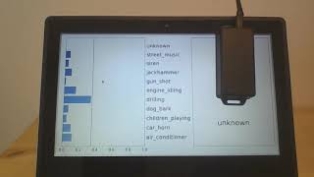
Automatic classification of noise for Noise Monitoring
Notes:
Environmental Sound Classification on Microcontroller
Demo
https://www.youtube.com/watch?v=KQHQxMG1CZo
Full talk https://www.youtube.com/watch?v=ks5kq1R0aws&feature=youtu.be

Slide 5
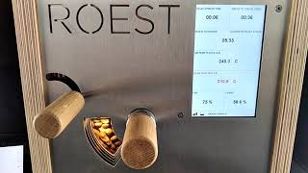
Tracking coffee bean roasting
Notes:
Roest Demo https://www.youtube.com/watch?v=GiwLluM5d2o Full talk https://www.youtube.com/watch?v=muZY1eCke40&feature=youtu.be

Slide 6
Feasibility
Machine Learning requires compute
Microcontrollers have limited
RAM, FLASH, CPU
What can be done & not (on generic microcontroller)
Notes:
Limitations. RAM, FLASH, CPU
Microcontrollers span a large range Trend: Getting more power for same price
Show a simplified matrix? Boards vs abilities?

Slide 7
Task feasibility versus microcontroller type
 | RAM (kB) | FLASH (kB) | CPU (CoreMark) |  | IMU 100 hz 5 s | Sound 16 kHz 1 s | Image 64x64 px 1 fps
Arduino Uno ATMega 328 @ 16 Mhz | 2 | 32 | 4.0 |  | ✓ | ❌ | ❌
Arduino Nano BLE 33 NRF52840 ARM Cortex M4F @ 64 Mhz | 256 | 1 000 | 215 |  | ✓ | ✓ | ❌
Arduino Nano ESP32 ESP32-S3 @ 240 Mhz | 8 000 | 16 000 | 613 (per core) |  | ✓ | ✓ | ✓
Teensy 4.0 ARM Cortex M7 @ 600 Mhz | 1 000 | 2 000 | 2313 (per core) |  | ✓ | ✓ | ✓
Notes:
Coremark Mega 7.03 https://github.com/PaulStoffregen/CoreMark https://www.eembc.org/coremark/scores.php
Accelerometers/IMU 100-1kHz. Every N seconds. Human Activity Detection Basically anything ?
Sound
Typ 16 khz. Not 48 kHz
Specialized detectors. 1-100 classes
Image/video.
Low resolution, low framerate.
Specialized detectors. 1-10 classes. Not ImageNet Classification and object detection. Edge Impulse FOMO OpenMV
https://docs.edgeimpulse.com/docs/edge-impulse-studio/learning-blocks/object-detection/fomo-object-detection-for-constrained-devices

Slide 8
Examples
For Getting Started

Slide 9
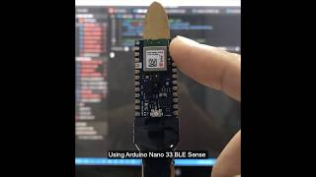
“Magic Wand” using Accelerometer

Slide 10
“Magic Wand” using Accelerometer
TensorFlow Lite Micro Arduino library https://github.com/tensorflow/tflite-micro-arduino-examples#how-to-install
Create custom gestures. Online gesture recorder
https://tinyml.seas.harvard.edu/magic_wand/
tinyML Summit 2021 Tutorial: Building a Magic Wand (Pete Warden)
https://www.youtube.com/watch?v=vKRdQHO7tIY

Slide 11
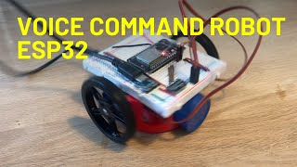
Speech Command Recognition using Microphone
Notes:
https://github.com/tensorflow/tflite-micro/tree/main/tensorflow/lite/micro/examples/micro_speech

Slide 12
Speech Command Recognition using Microphone
Build Your Own Voice-Controlled Robot with ESP32 & TensorFlow Lite
https://www.youtube.com/watch?v=cp2qRrhaZRA
Official example
https://github.com/tensorflow/tflite-micro/ tree/main/tensorflow/lite/micro/examples/micro_speech
Can train custom models Can be adapted to detecting Sound Events that are not speech
Notes:
https://github.com/tensorflow/tflite-micro/tree/main/tensorflow/lite/micro/examples/micro_speech

Slide 13
Object Detection / Object tracking using camera
Notes:
### Object detection

Slide 14
Object Detection / Object tracking using camera
OpenMV Tensorflow Lite micro https://docs.openmv.io/library/omv.tf.html
Cup detection
OpenMV Convolutional Neural Network
https://github.com/ARM-software/EndpointAI/tree/ 60b2a782194d74662eaf57051c71b799f5076f60/ProofOfConcepts/Vision/OpenMvCupDetect
OpenMV Arduino tutorial face detection Haar
https://docs.arduino.cc/tutorials/portenta-vision-shield/creating-basic-face-filter/
Notes:
### Object detection

Slide 15
My Projects

Slide 16

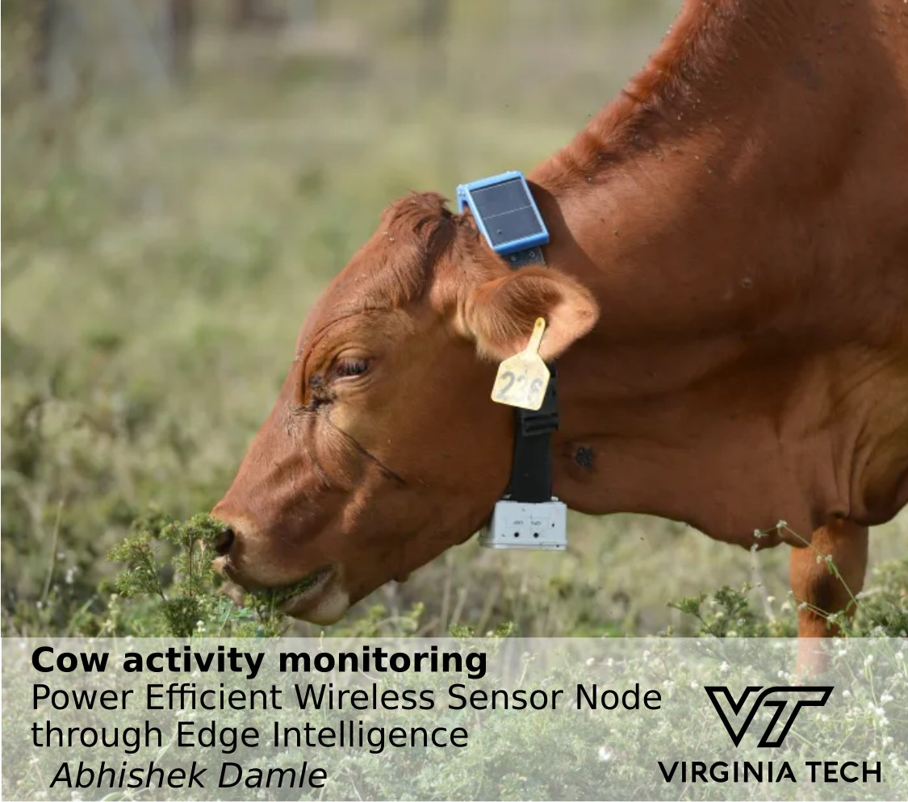

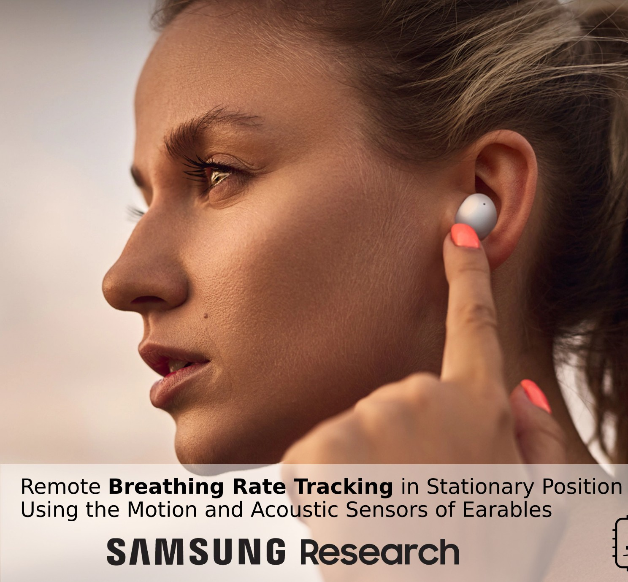
emlearn
Project for “classical” ML models (pre neural-networks)
Running on the smallest microcontrollers < 16 kB RAM Used in 30+ RnD projects worldwide
http://github.com/emlearn/emlearn
Notes:
### Object detection

Slide 17
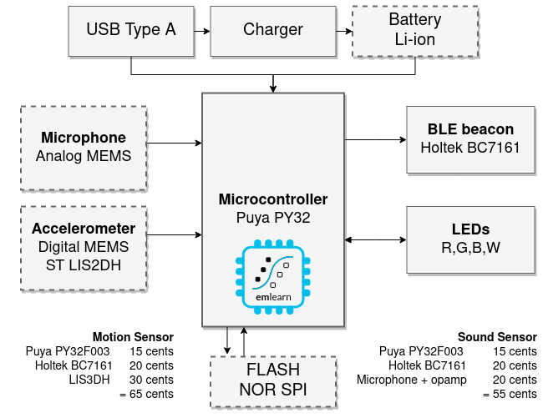
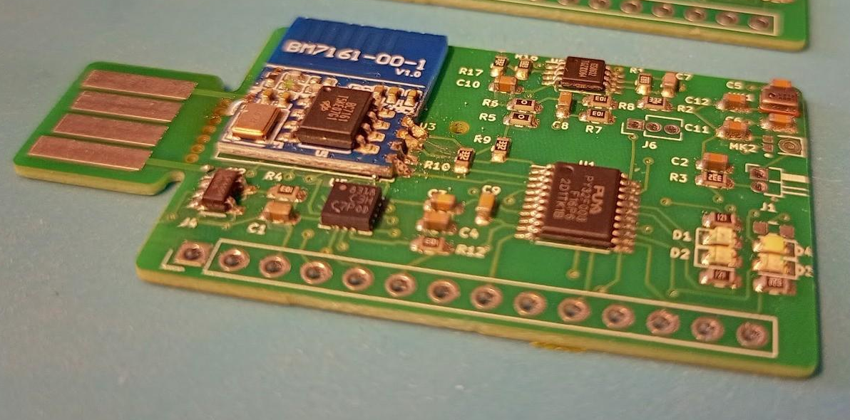
1 dollar TinyML system
Goal: Sound and accelerometer sensing using ML for under 1 USD in total component cost (BOM)
https://hackaday.io/project/194511-1-dollar-tinyml
Challenge: 3 kB RAM / 32 kB FLASH
Notes:
### Object detection

Slide 18
Summary
Machine Learning is used in sensor-systems to extract useful information
Current microcontrollers can handle many tasks: motion data, sound and image analysis
Open source software libraries available
Notes:
TinyML cookbook https://www.packtpub.com/product/tinyml-cookbook-second-edition/9781837637362 Gian Marco Iodice
TinyML: Machine Learning with TensorFlow Lite on Arduino and Ultra-Low-Power Microcontrollers https://www.amazon.com/TinyML-Learning-TensorFlow-Ultra-Low-Power-Microcontrollers/dp/1492052043

